Slide 1
Financial Training for
State Committees
Presented by
Julie Collins

Slide 2


Slide 3
“What do you need your Advisory Councils to know?”
“Training. The Advisory Councils need to train themselves and their volunteers on things financial. I become the ogre and spend time fixing bad assumptions and [incorrect info] information. Volunteers get frustrated because they send me [incorrect info] that the KairosDonor Coordinator / Chair slides by.
I have trained everyone who bothered to show up at training: financial folks, council reps, etc.
I have written a financial guide for volunteers, given it to Advisory Council Reps and Chairs, and provide it to anyone who asks for an advance.
The response is, ‘I saw it, but I didn’t read it.’”

Slide 4

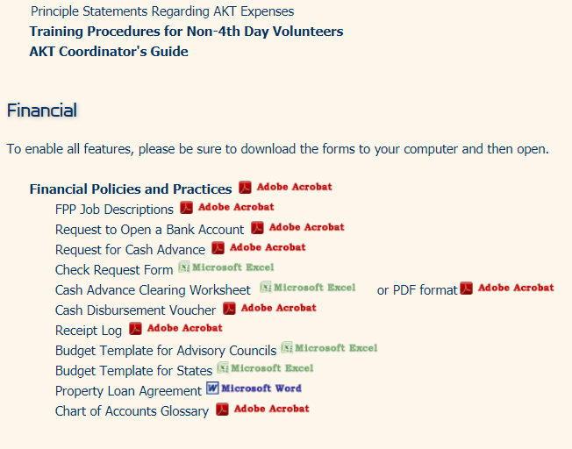
www.mykairos.org/downloads

Slide 5
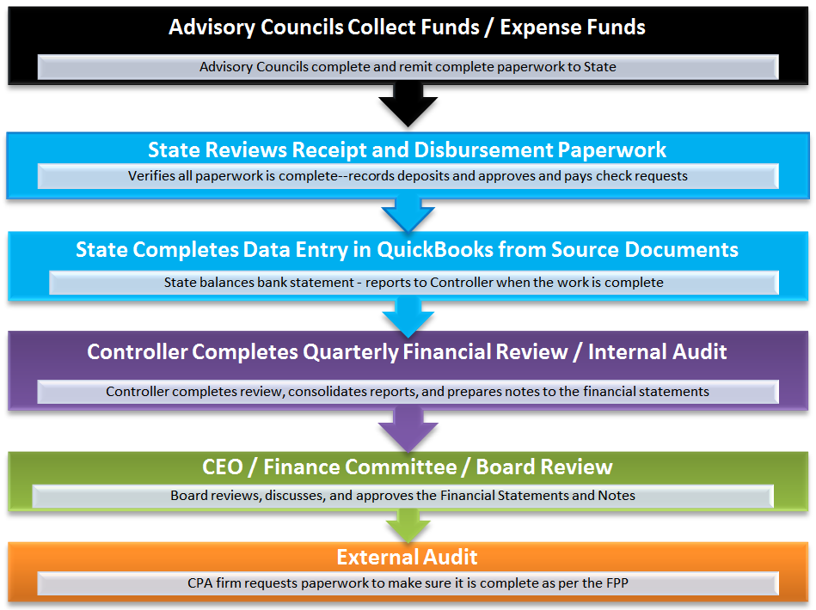

Slide 6

“What is my balance?”

Slide 7
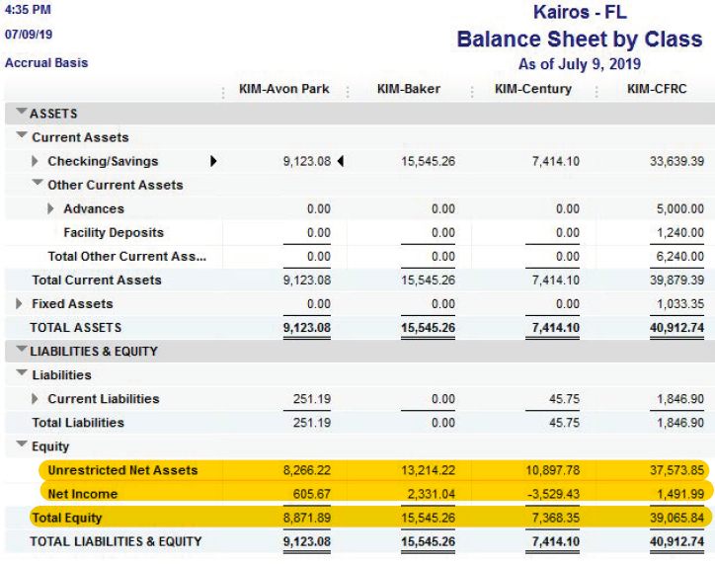

Slide 8
Common Errors on the Audit
Deposits
  Two signatures missing on receipt log (dual control)
  KairosDonor information missing
  Redacted copies of deposited checks
Disbursements
  Disbursements / Advances not recorded in correct month
  Advances do not have legible receipts
  Check Request Form not utilized
  Old forms used (do not have correct authority signature lines)
  Electronic Signatures not approved on audit

Slide 9
Solutions to Common Issues
Develop Relationships
  Communication (CA | FL | TX)
  Visit new KairosDonor Coordinators (AL | FL)
Training (AL | FL | SC | TX)
  Schedule training as soon as possible
    SCC Meeting
    Breakout workshops at SCC training
Document Control
  Dropbox (CA)
  File Names (CA)
  Document Control Form (AL | SC)

Slide 10
Good communication is imperative!
First and Foremost, you will communicate with the KairosDonor Coors primarily and they will communicate with their Treasurers and AC’s
Reward compliant Advisory Councils in Public Settings
You must lead with good, relevant, and informative emails
You must respond to their emails like you want them to respond to yours

Slide 11

South
Carolina
Training

Slide 12
“5-5-5 Rule” (AL)
Day of Collection → Completed and signed by two counters
within 5 days of collection → Deposit is done
                deposit ticket copy
                deposit receipt from bank
                redacted copies of deposited checks
within 5 days of deposit → Documents sent to KairosDonor Coordinator
                KairosDonor data entry complete
                Deposit List complete
within 5 days of Donor work → KairosDonor Coor sends docs to State Fin Sec

Slide 13
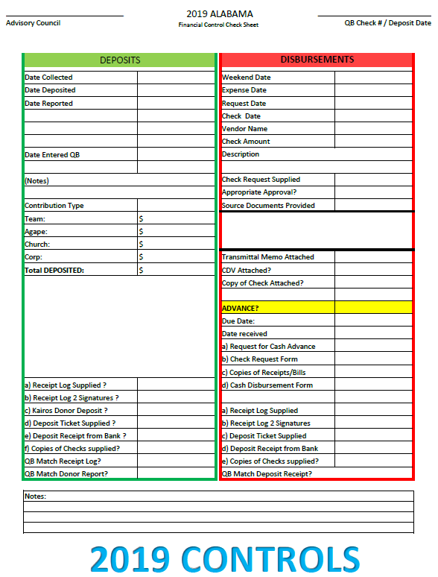

Slide 14
I am missing deposit documentation . . .
          Now what??

Slide 15
Deposit Tracking (SC)
Maintain “Tracking Sheet” (based on Test of Controls doc)

Slide 16
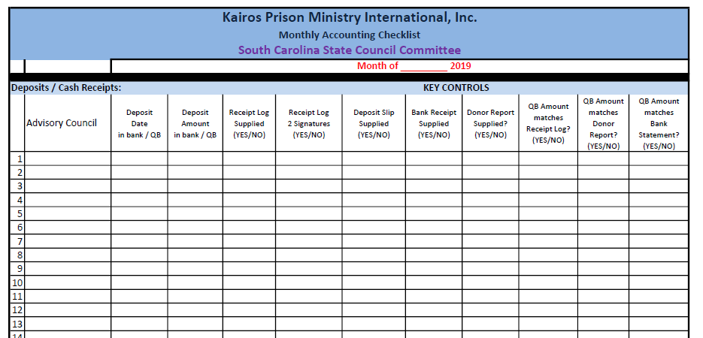

Slide 17
Deposit Tracking (SC)
Maintain “Tracking Sheet” (based on Test of Controls doc)
  Online access to see the deposit slips / deposited checks
  Track each deposit
Receive documentation via email / Dropbox
  Follow-up at the end of the month for missing information

Slide 18
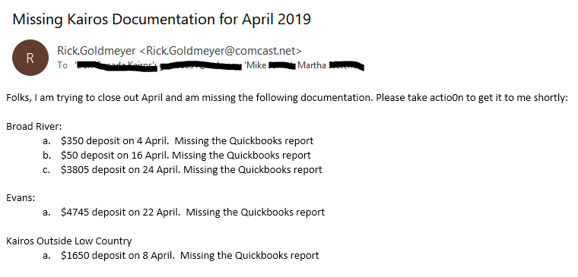

Slide 19
Deposit Tracking (SC)
Maintain “Tracking Sheet” (based on Test of Controls doc)
  Online access to see the deposit slips / deposited checks
  Track each deposit
Receive documentation via email / Dropbox
  Follow-up at the end of the month for missing information
  (email KairosDonor Coordinators / Treasurers)
Consider action on non-responsive Advisory Councils

Slide 20
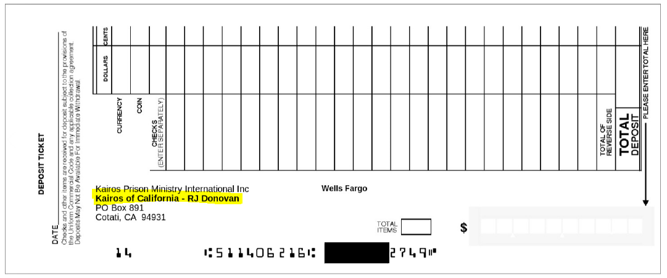
Customized Deposit Slips (CA)

Slide 21
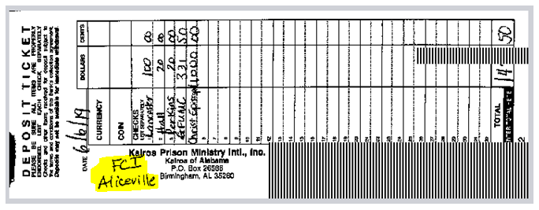
“Handmade” Customized Deposit Slips (AL)

Slide 22
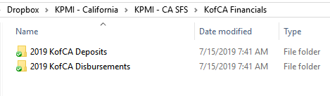
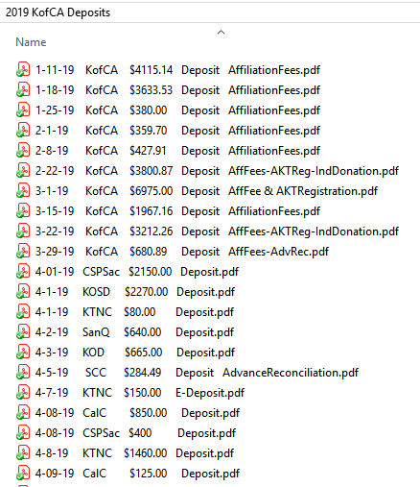
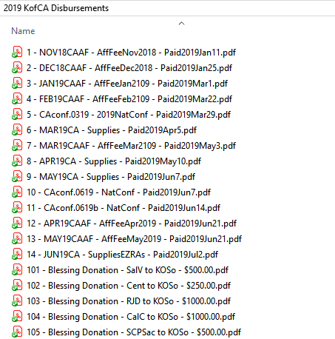
Dropbox Setup (CA)

Slide 23
Digital Signatures (IN | AK)
DocuSign
https://www.docusign.com/
Adobe Sign
https://acrobat.adobe.com/us/en/sign/capabilities/digital-signatures.html

Slide 24
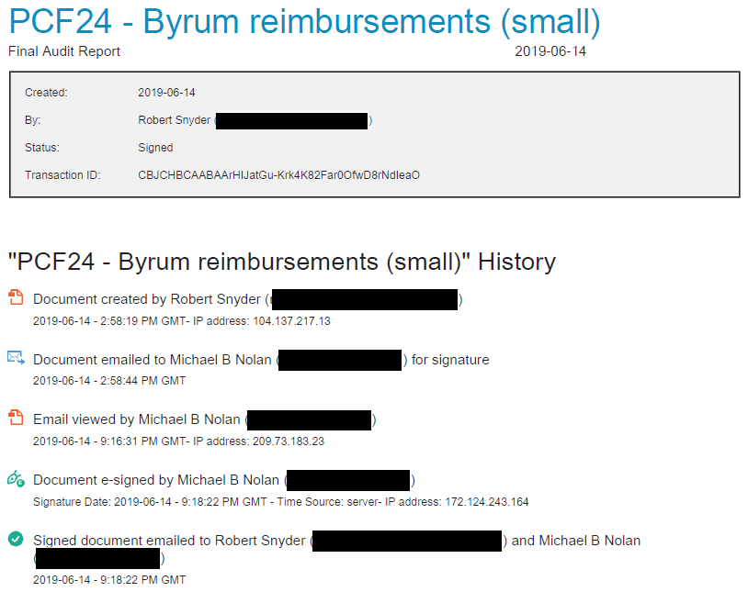

Slide 25
Accountability
Table Groups ----
  How do you get problem Advisory Councils to cooperate?
  How do you reward those that routinely cooperate?

Slide 26


